Slide 1
Beginning with R
Gina Griffin December 2019 R-Ladies Tampa!

Slide 2
What is R?
R is a language and environment for statistical computing and graphics.
Developed at Bell Laboratories (formerly AT&T, now Lucent Technologies) by John Chambers and colleagues. R can be considered as a different implementation of S.
R provides a wide variety of statistical (linear and nonlinear modelling, classical statistical tests, time-series analysis, classification, clustering and graphical techniques.
One of R’s strengths is the ease with which well-designed publication-quality plots can be produced, including mathematical symbols and formulae where needed. Great care has been taken over the defaults for the minor design choices in graphics, but the user retains full control.
(Source: https://www.r-project.org/about.html)

Slide 3
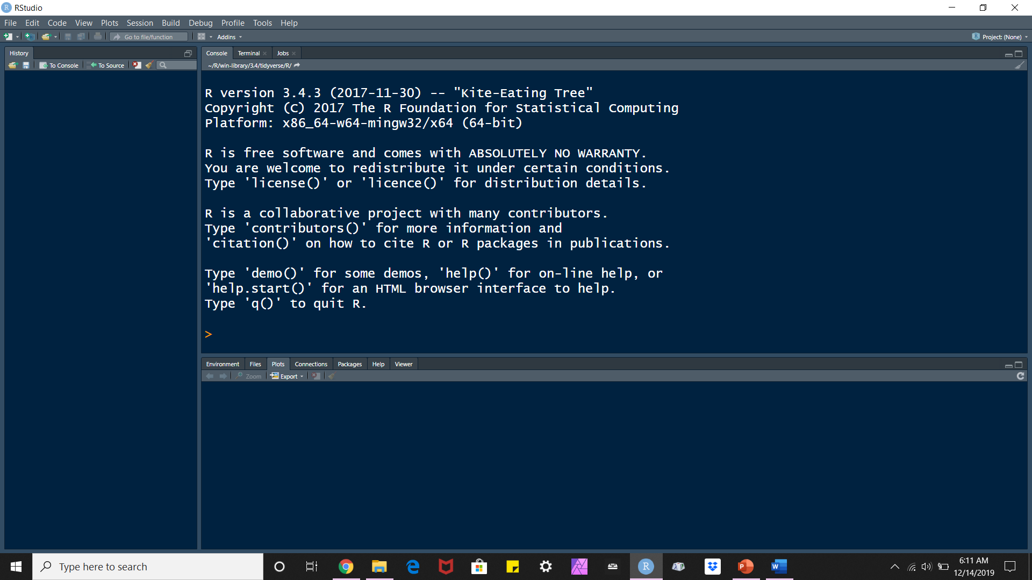
What can you do with R?
R is an integrated suite of software facilities for data manipulation, calculation and graphical display. It includes:
an effective data handling and storage facility
a suite of operators for calculations on arrays, in particular matrices
a large, coherent, integrated collection of intermediate tools for data analysis
graphical facilities for data analysis and display either on-screen or on hardcopy
a well-developed, simple and effective programming language which includes conditionals, loops, user-defined recursive functions and input and output facilities
(Source: https://www.r-project.org/about.html)

Slide 4
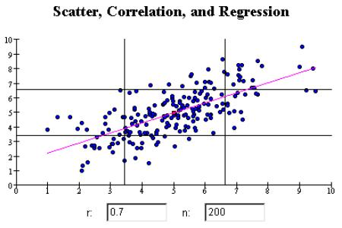
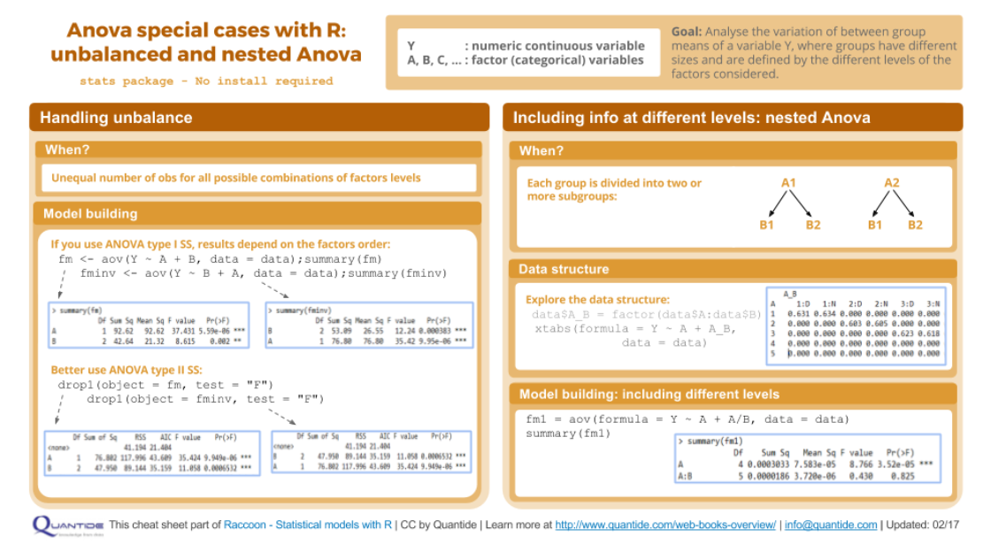
R in Research and Data Analysis
R is an extremely powerful programming language for statistical computing and graphics generation.
It's flexibility, extensibility, and no cost have contributed to R's wide use in academic environments and among statisticians.
R is a good choice for large or small statistical projects (Source: https://www.ssc.wisc.edu/sscc/pubs/RFR/RFR_Introduction.html)

Slide 5
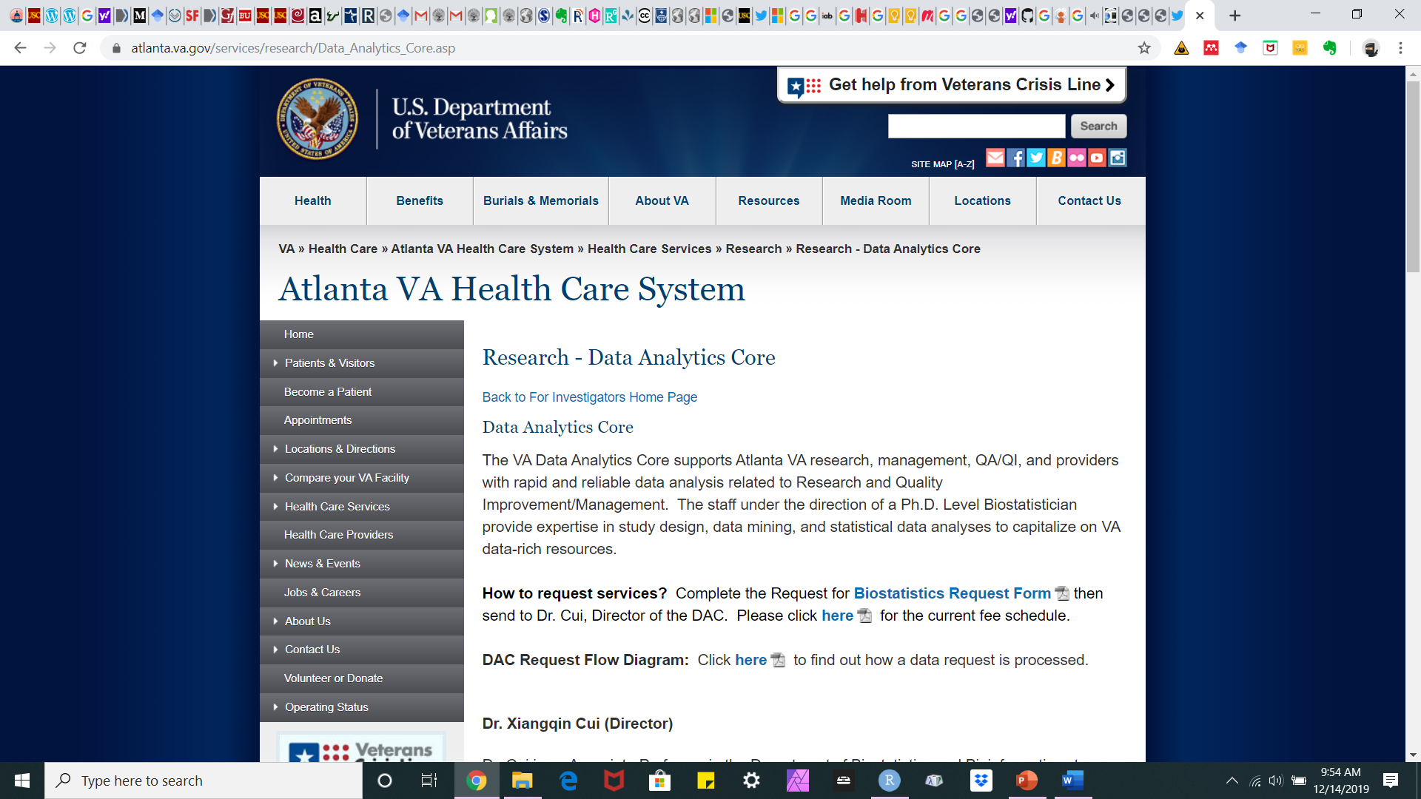
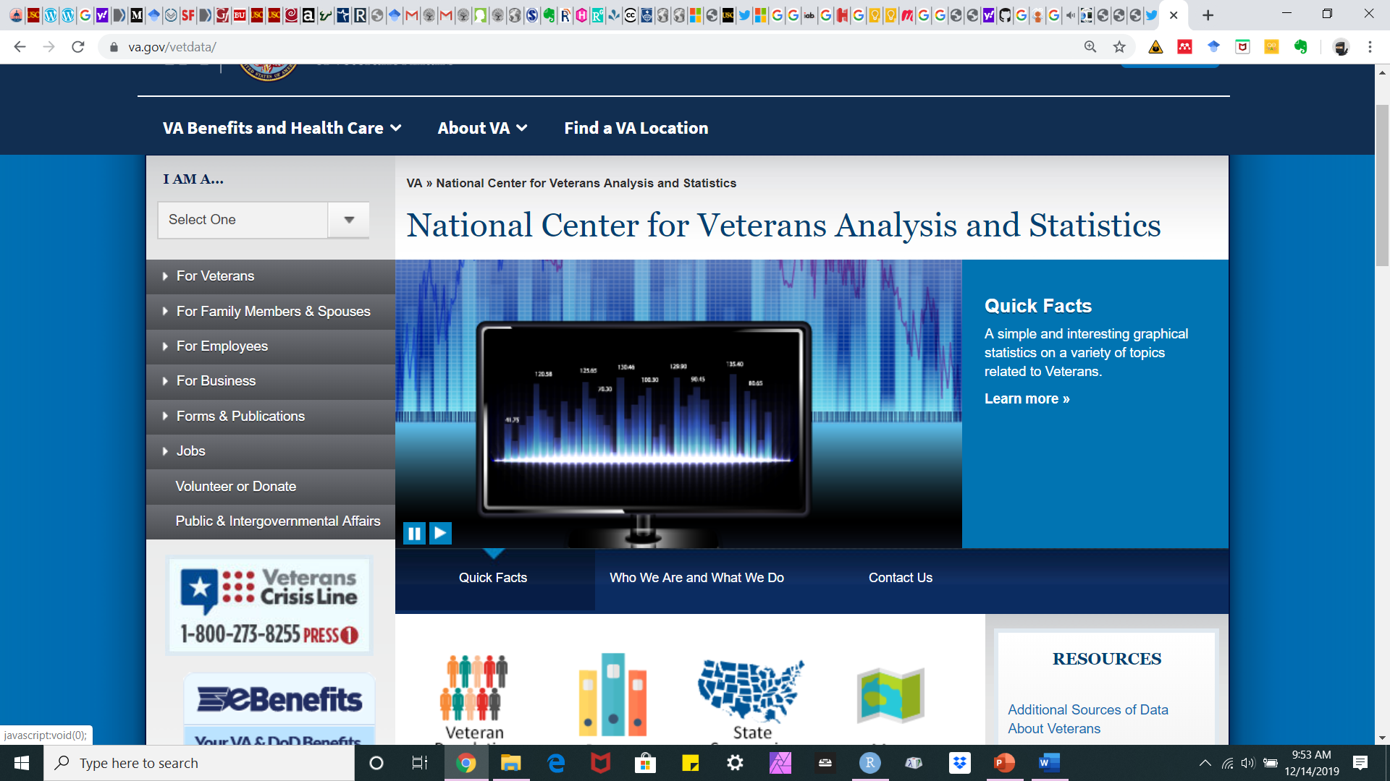
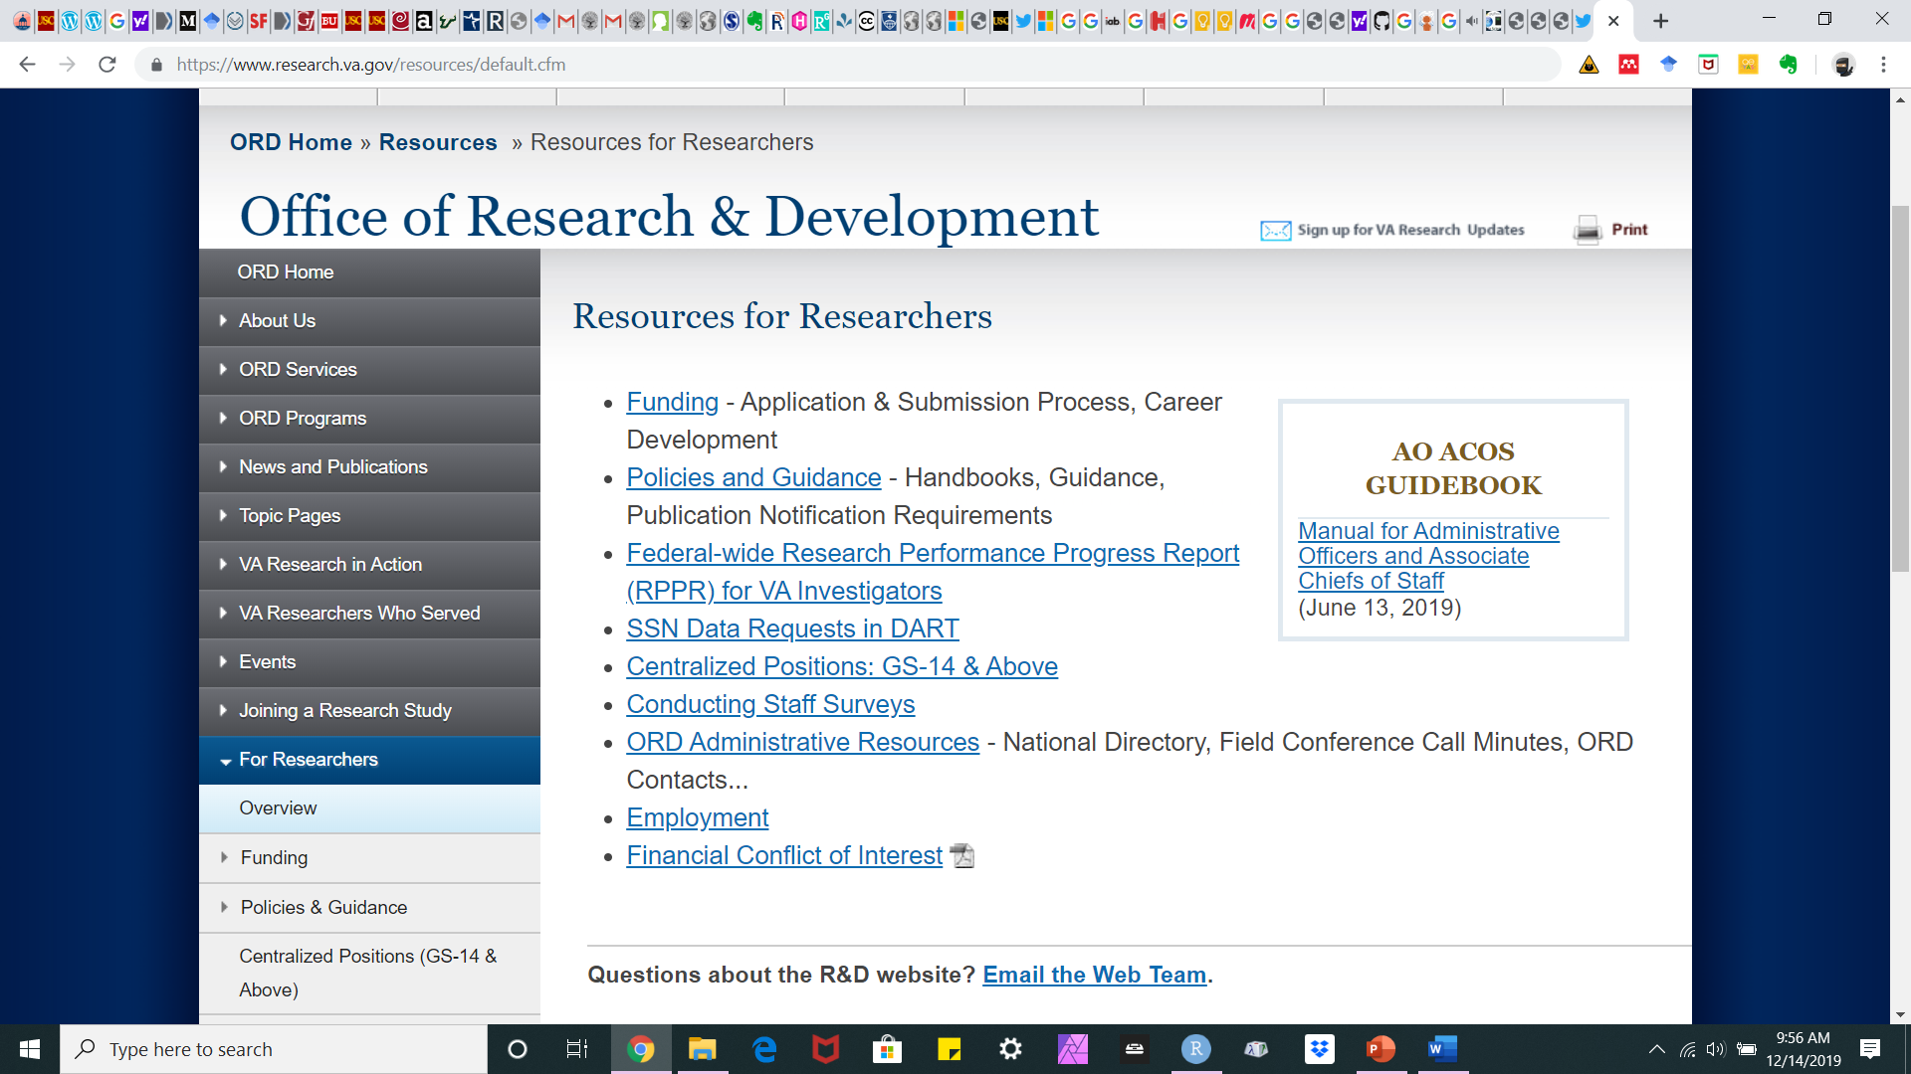
R in Research and Data Analysis
Where can you use it? Probably anywhere.

Slide 6
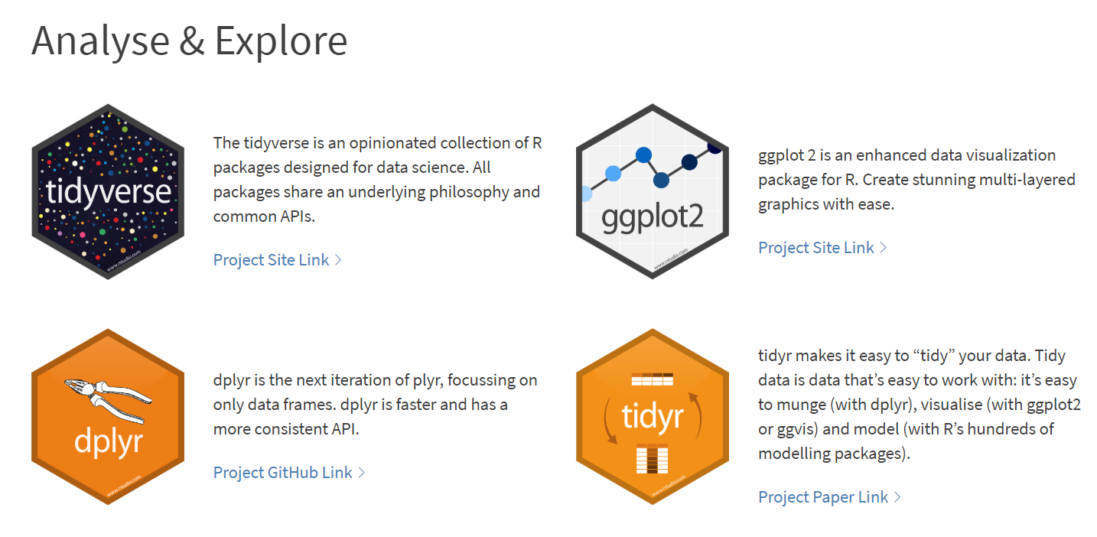
R Packages and Tidyverse

Slide 7
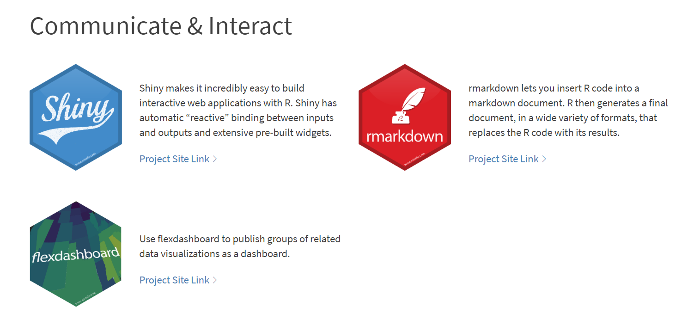
R Packages and Tidyverse (contd.)

Slide 8
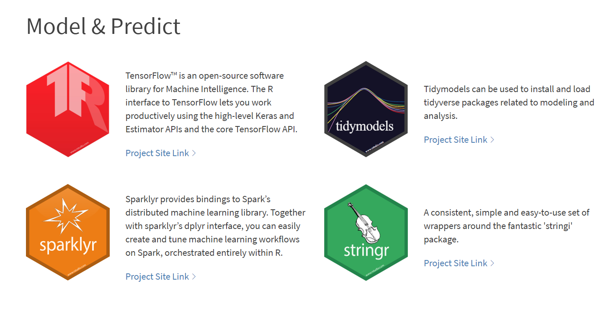
R Packages and Tidyverse (contd.)

Slide 9
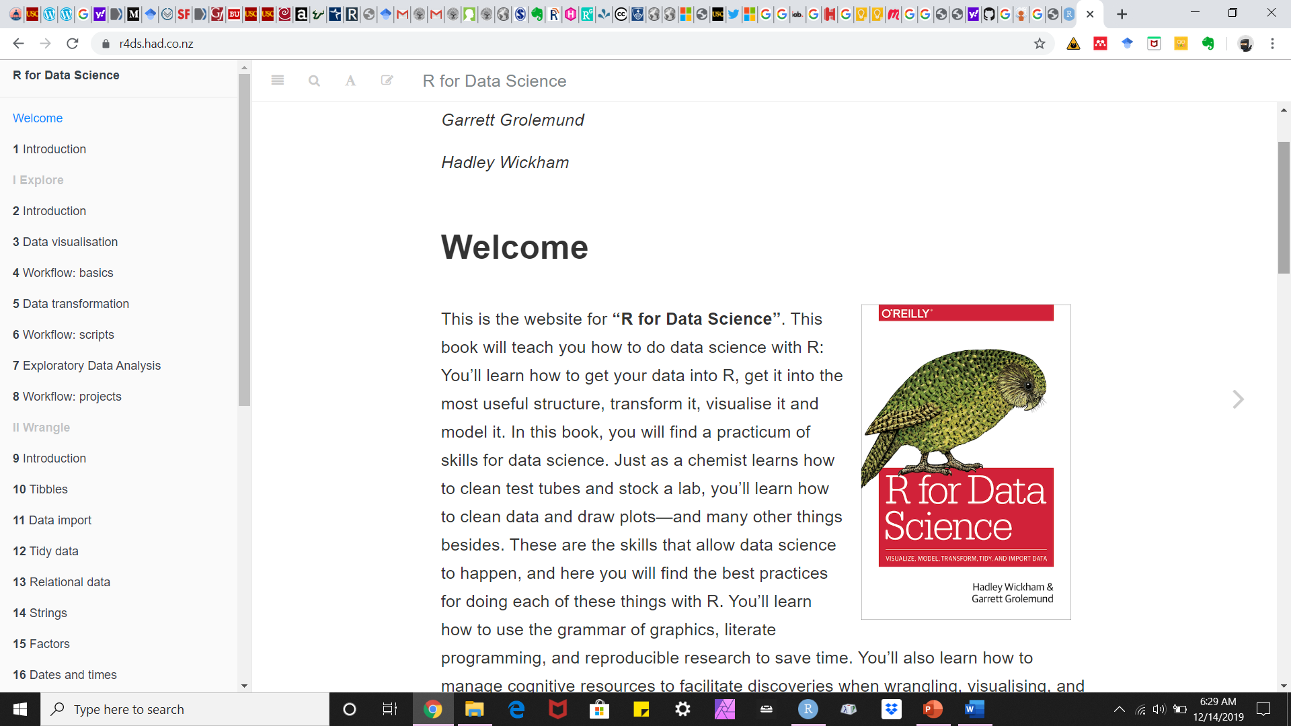
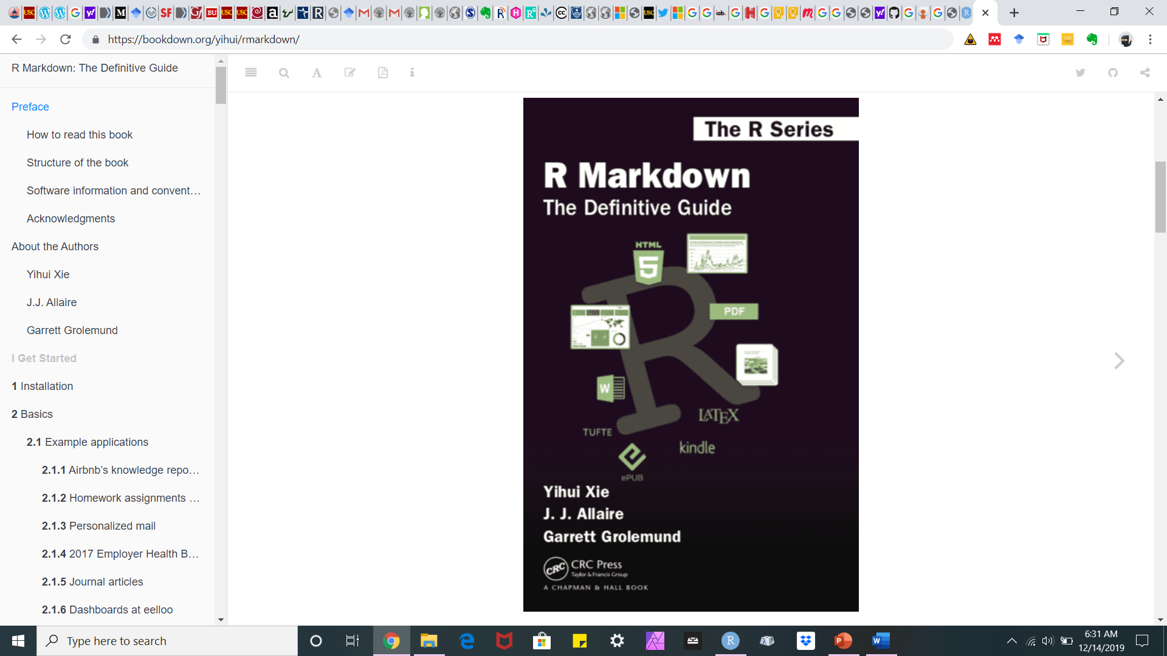
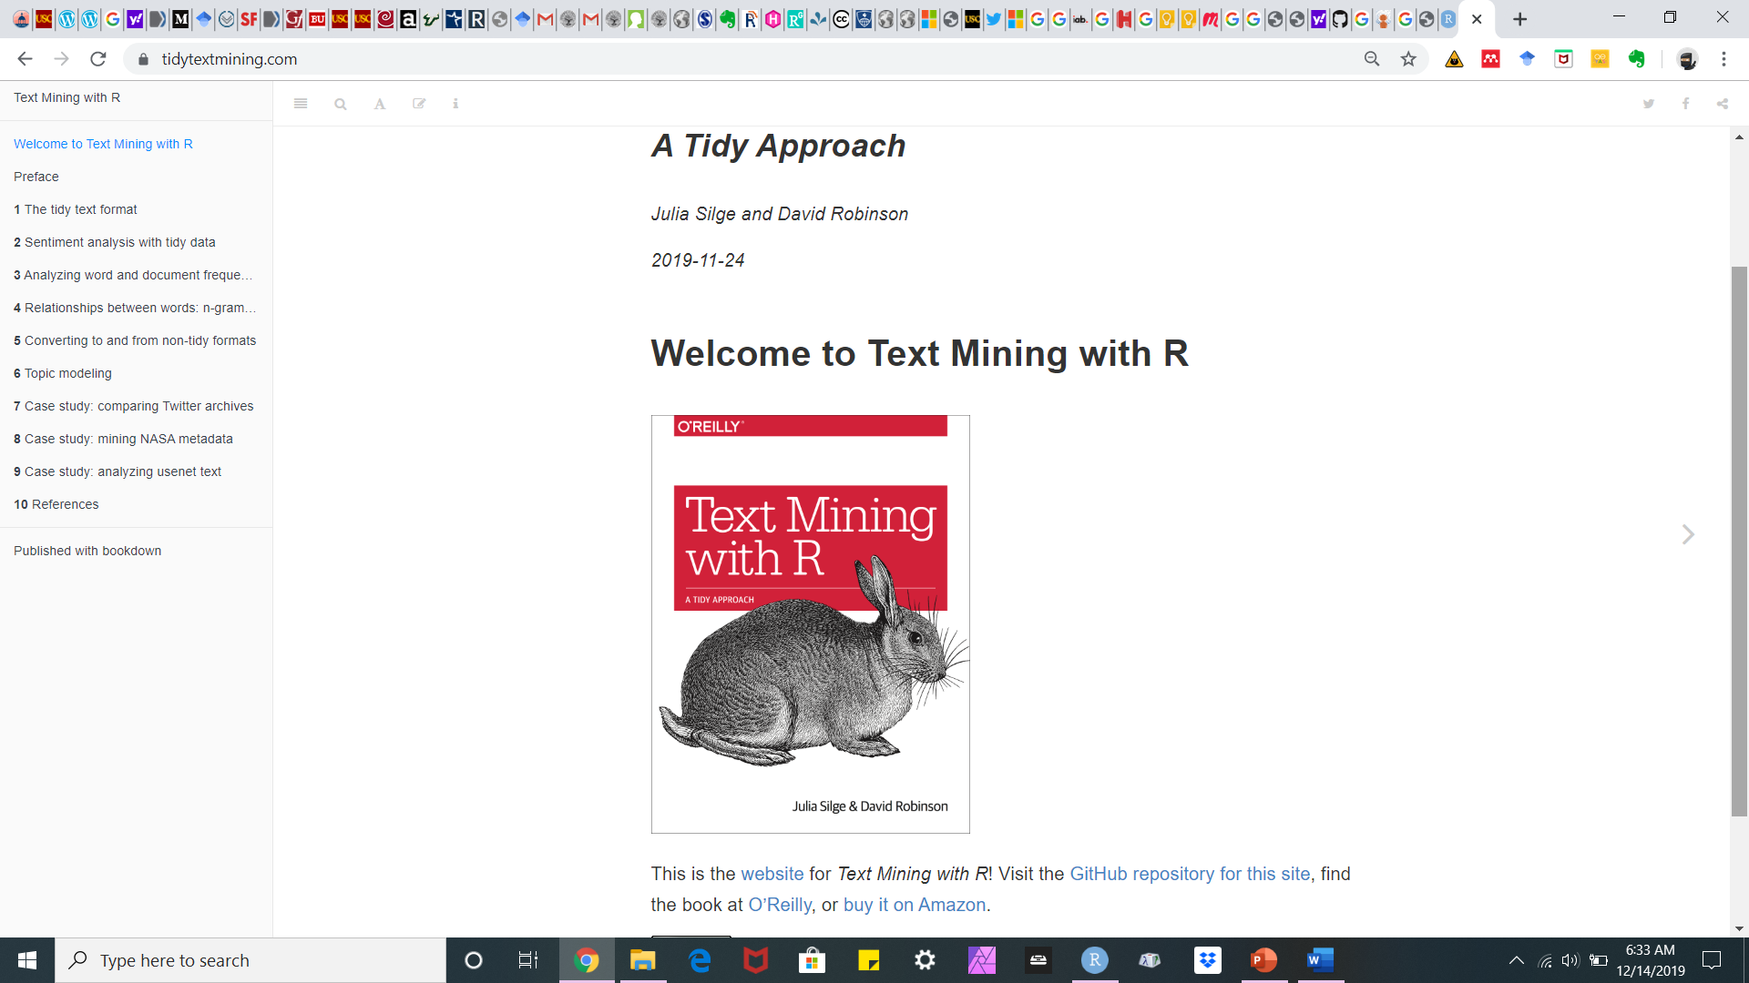
R Books
http://cmdlinetips.com/2018/01/free-online-resources-books-to-learn-r-and-data-science/

Slide 10
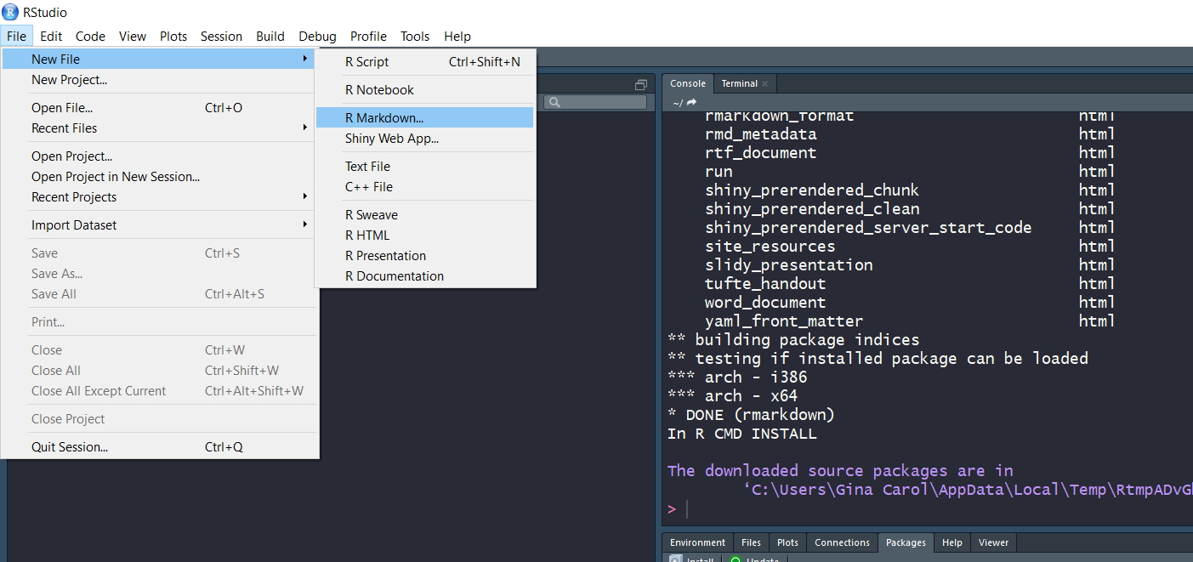
R Markdown Document:

Slide 11
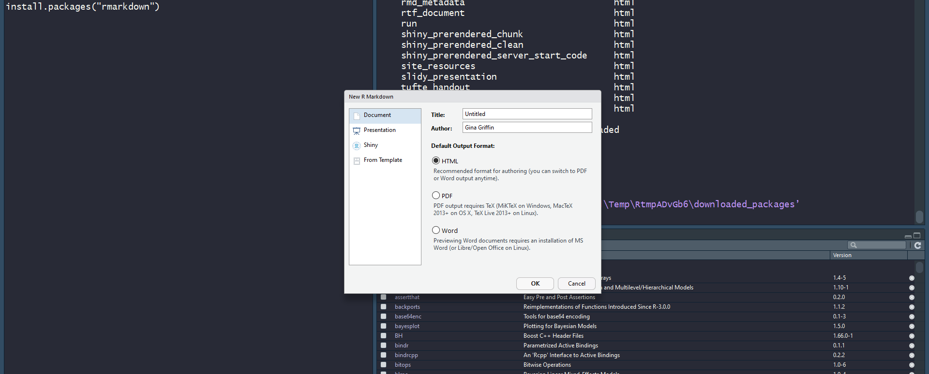
Types of document outputs include HTML (the default), PDF, Word…

Slide 12
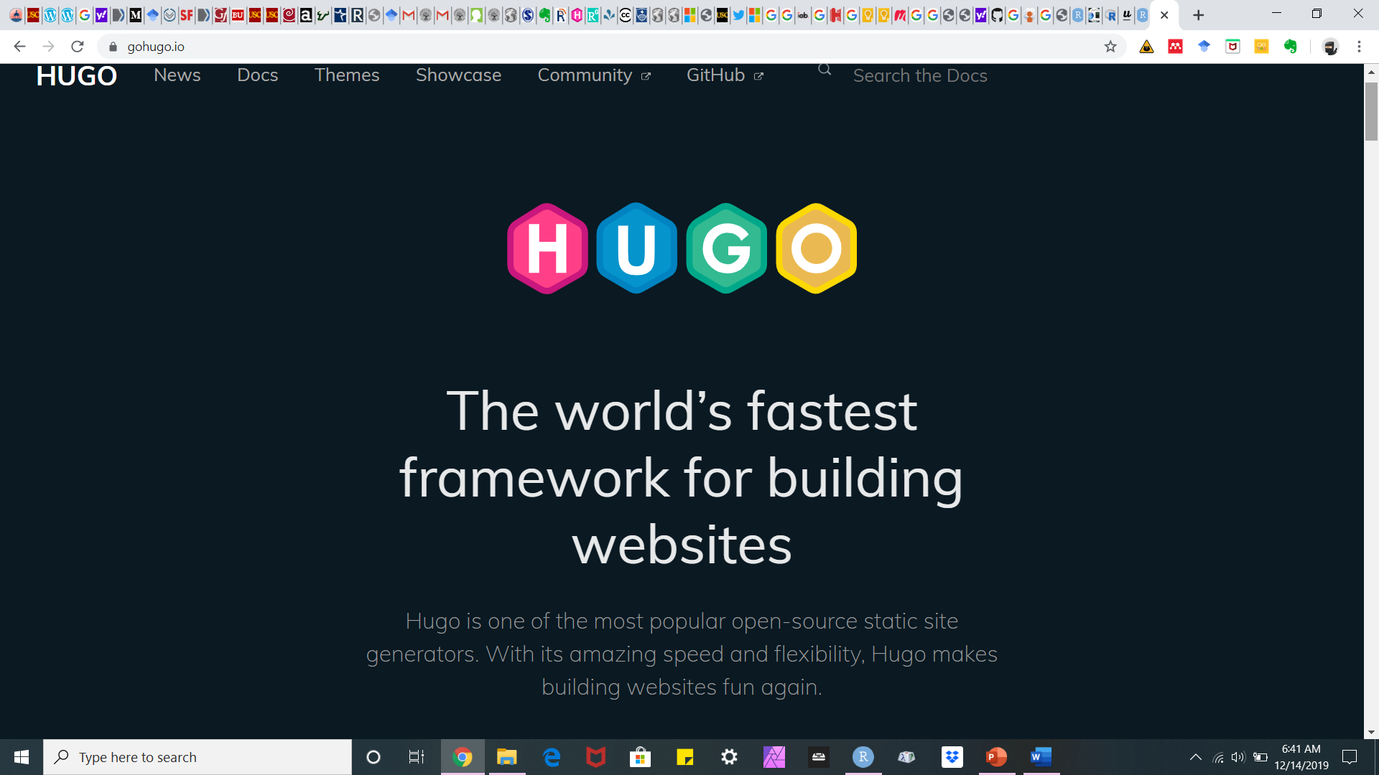
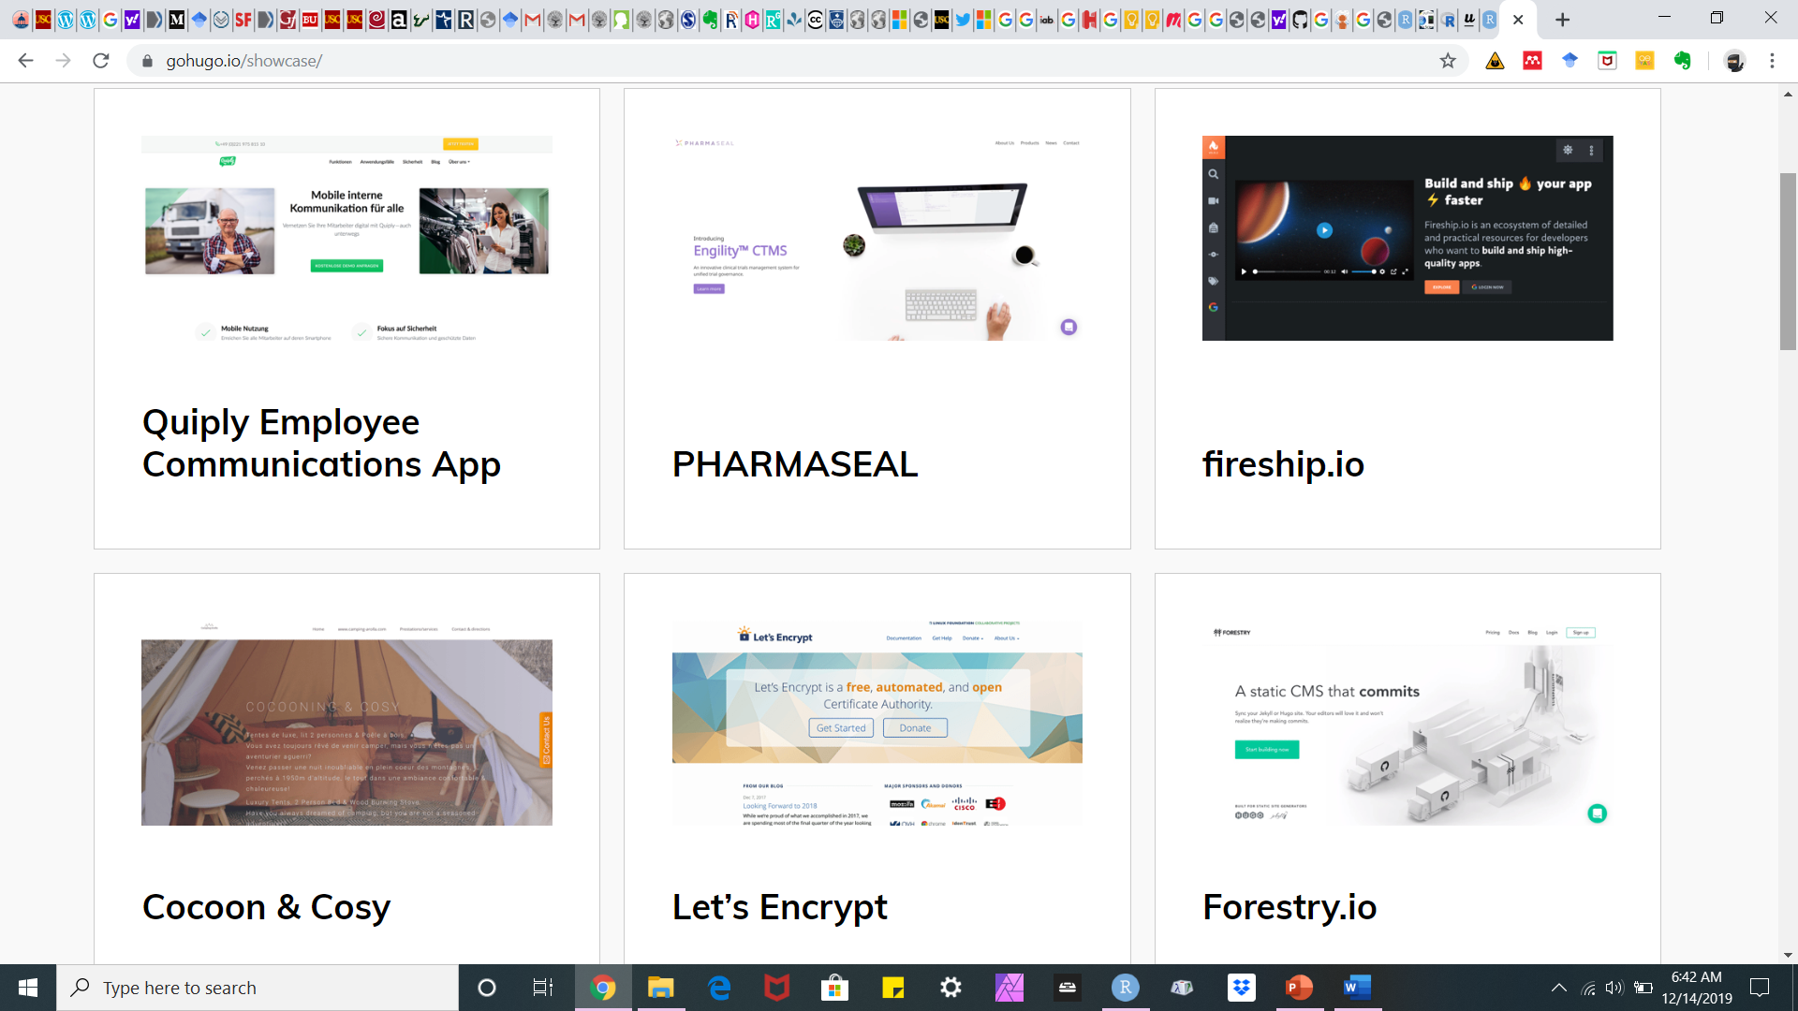
R and Websites
https://gohugo.io/

Slide 13
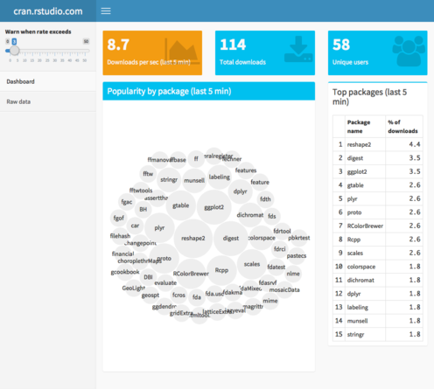
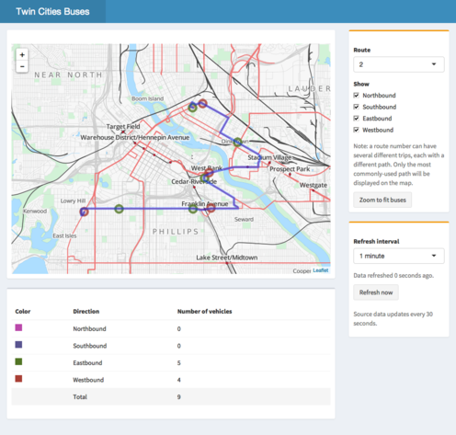
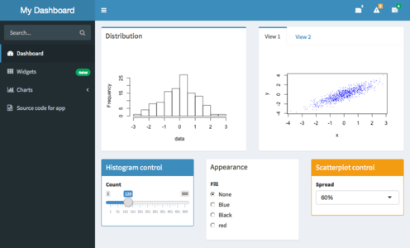
Shiny Dashboards
A data dashboard is an information management tool that visually tracks, analyzes and displays key performance indicators (KPI), metrics and key data points to monitor the health of a business, department or specific process. They are customizable to meet the specific needs of a department and company. Behind the scenes, a dashboard connects to your files, attachments, services and API’s, but on the surface displays all this data in the form of tables, line charts, bar charts and gauges. A data dashboard is the most efficient way to track multiple data sources because it provides a central location for businesses to monitor and analyze performance. Real-time monitoring reduces the hours of analyzing and long line of communication that previously challenged businesses.
(Source: https://www.klipfolio.com/resources/articles/what-is-data-dashboard)

Slide 14

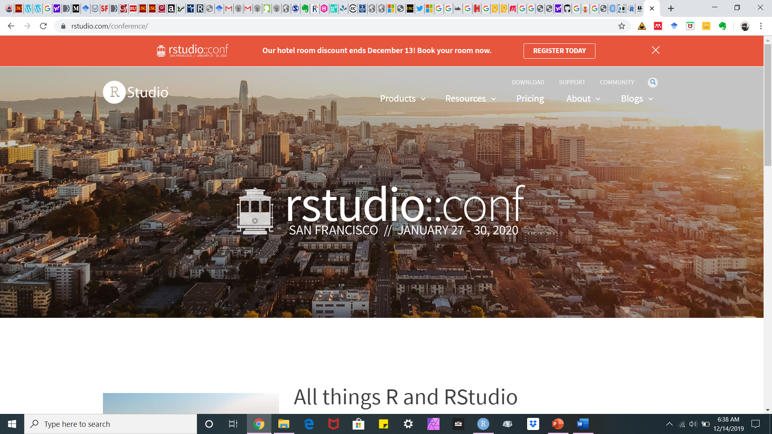
R Conferences
https://rstudio.com/conference/
https://user2020.r-project.org/

Slide 15
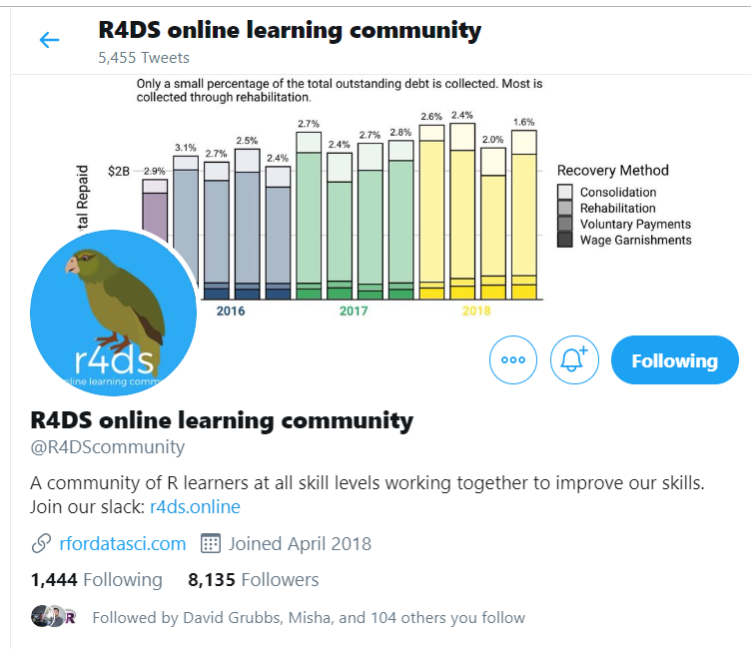

Ways to Learn R:
https://rladies.org/
https://www.rfordatasci.com/

Slide 16
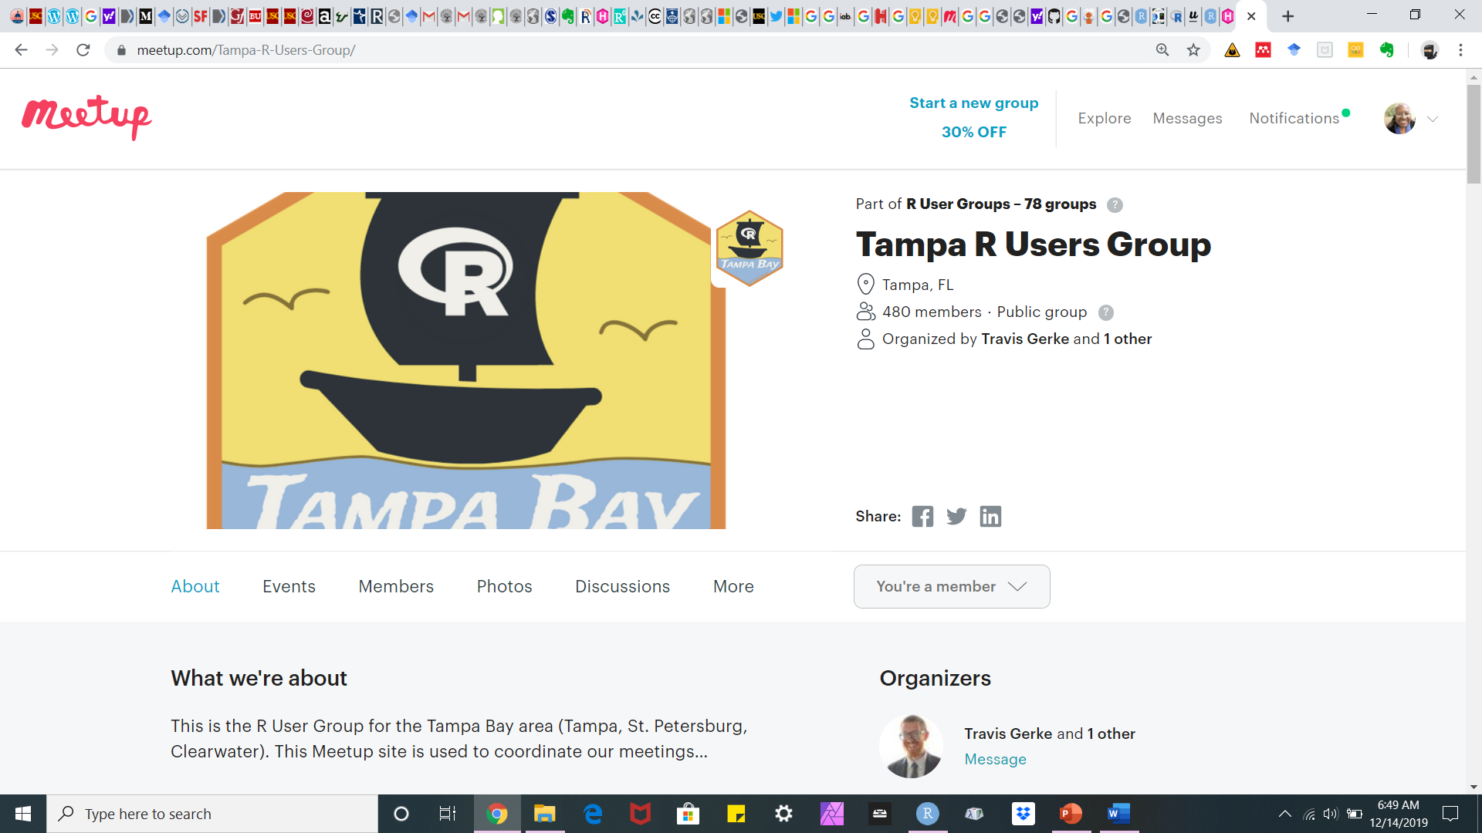
Ways to Learn R (contd):

Slide 17
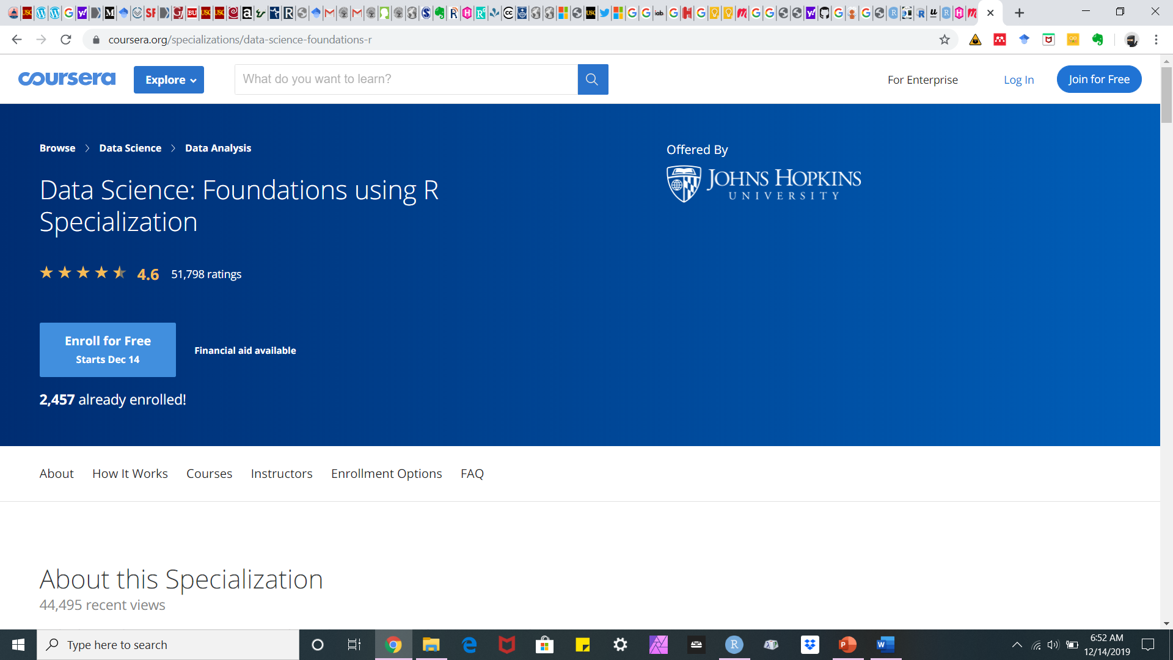
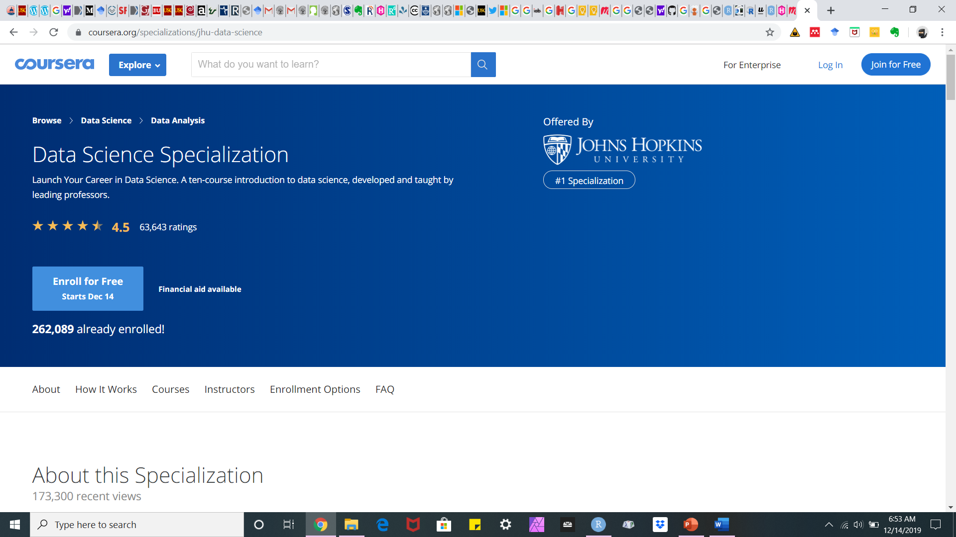
Ways to Learn R (contd):
https://www.coursera.org/specializations/data-science-foundations-r?

Slide 18
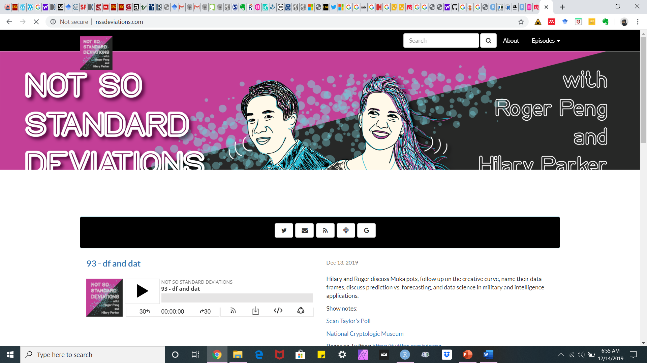
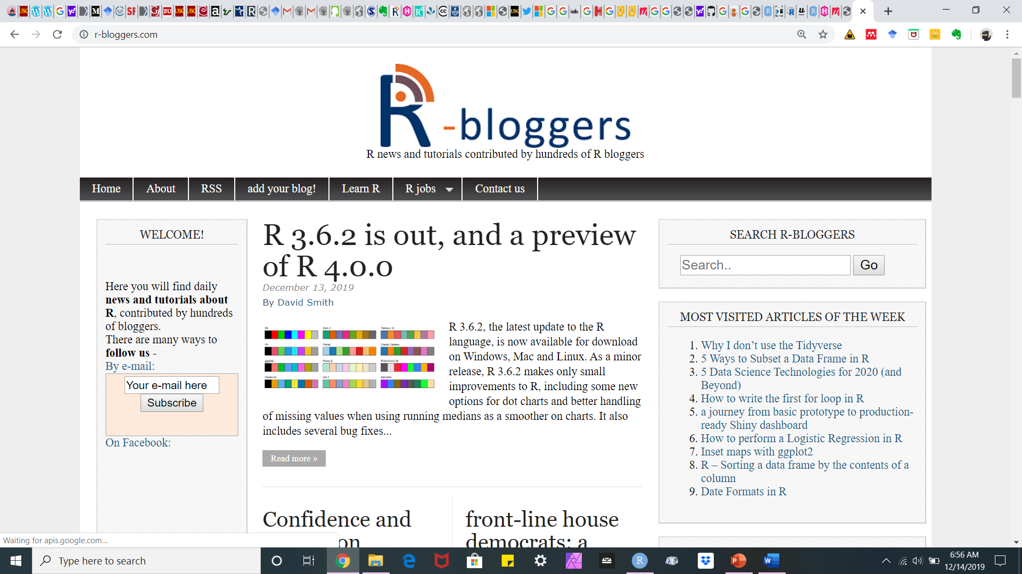
R Resources
https://www.r-bloggers.com/
http://nssdeviations.com/

Slide 19
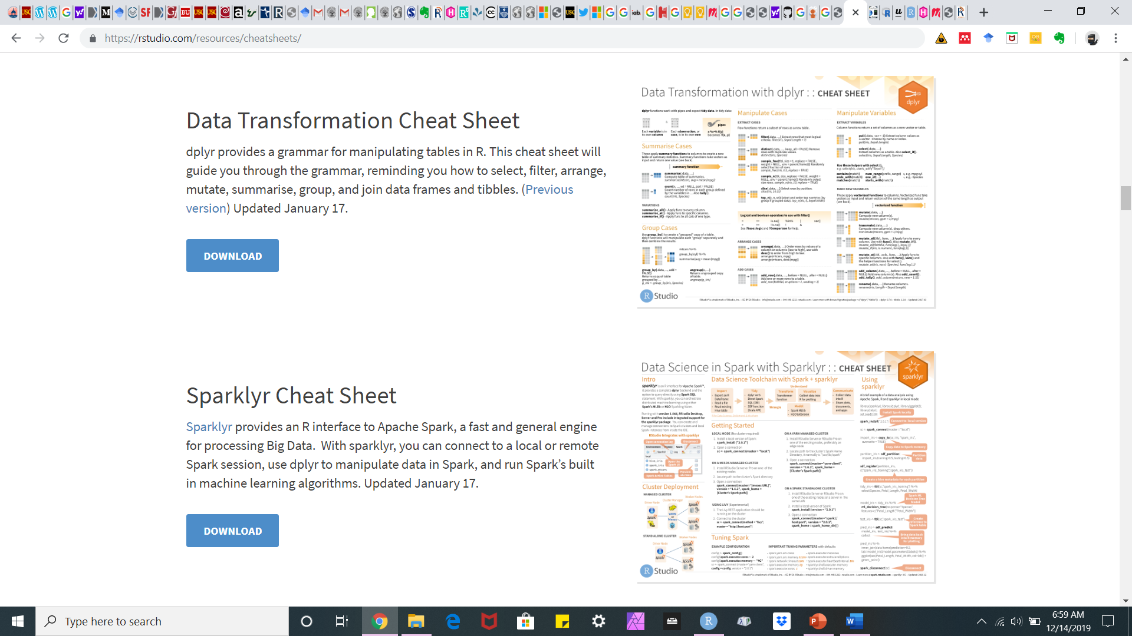
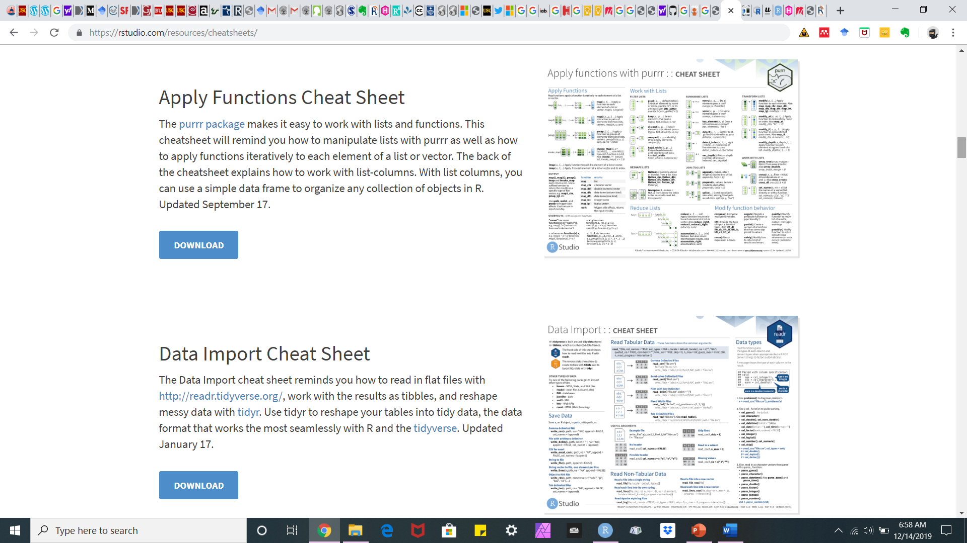
R Resources
https://rstudio.com/resources/cheatsheets/

Slide 20
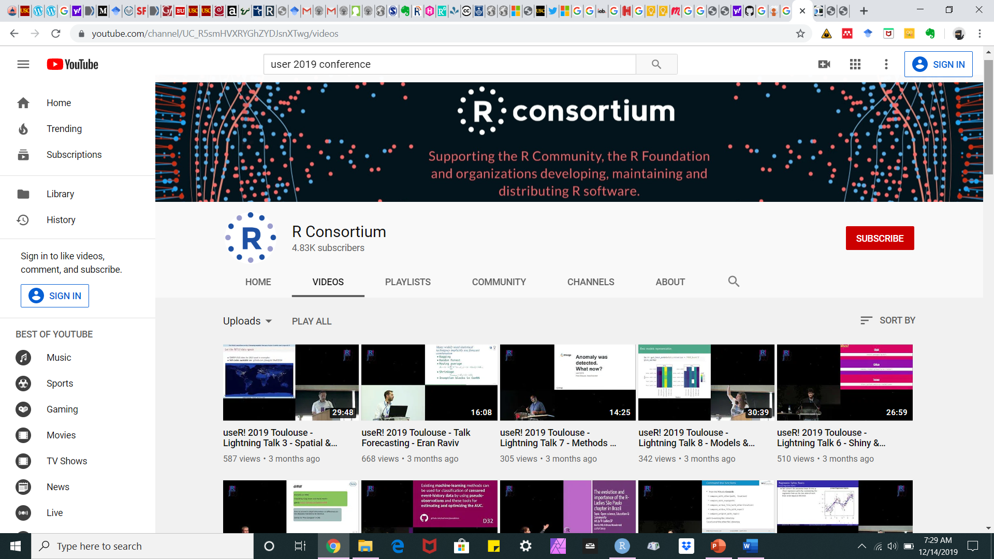
UseR! Videos
https://www.youtube.com/channel/UC_R5smHVXRYGhZYDJsnXTwg

Slide 21
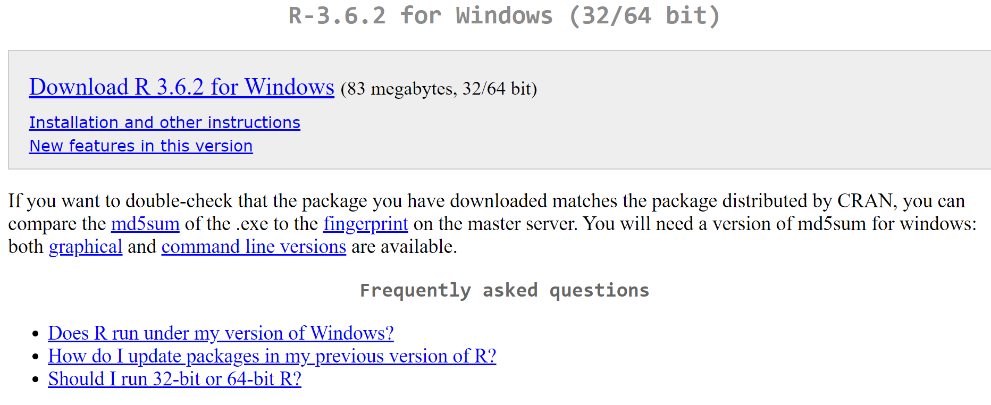
How to Start
Download Base R and R Studio:
https://cran.r-project.org/bin/windows/base/

Slide 22
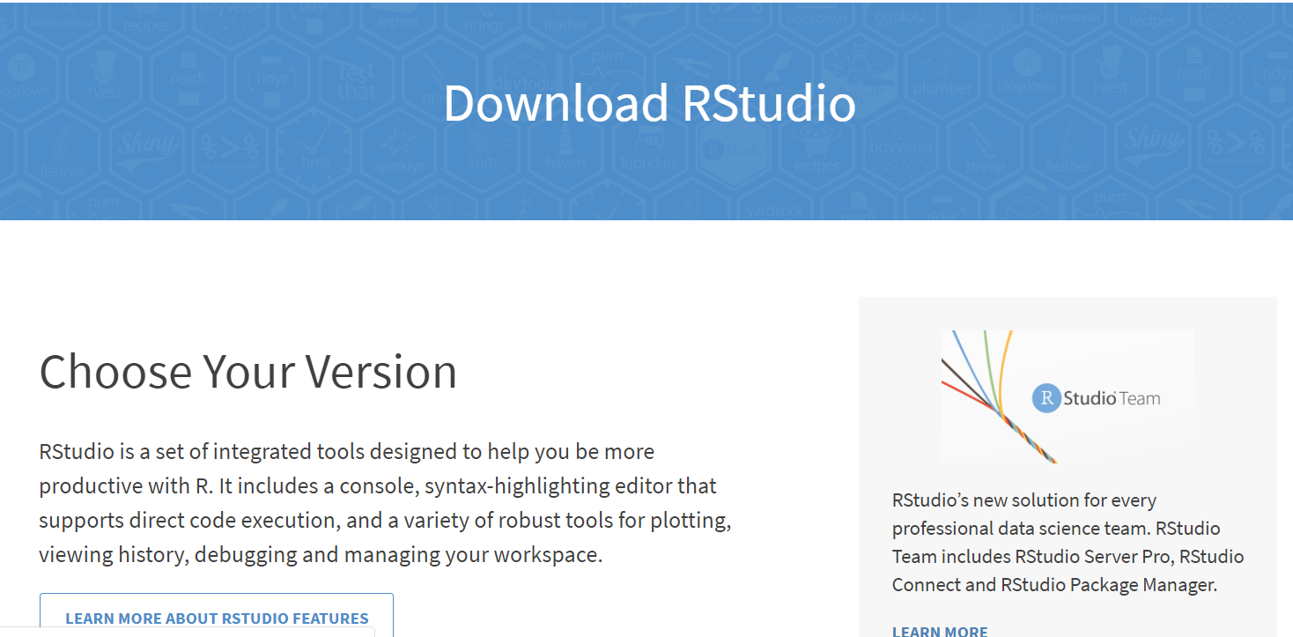
How to Start
https://rstudio.com/products/rstudio/download/
Download Base R and R Studio:

Slide 23
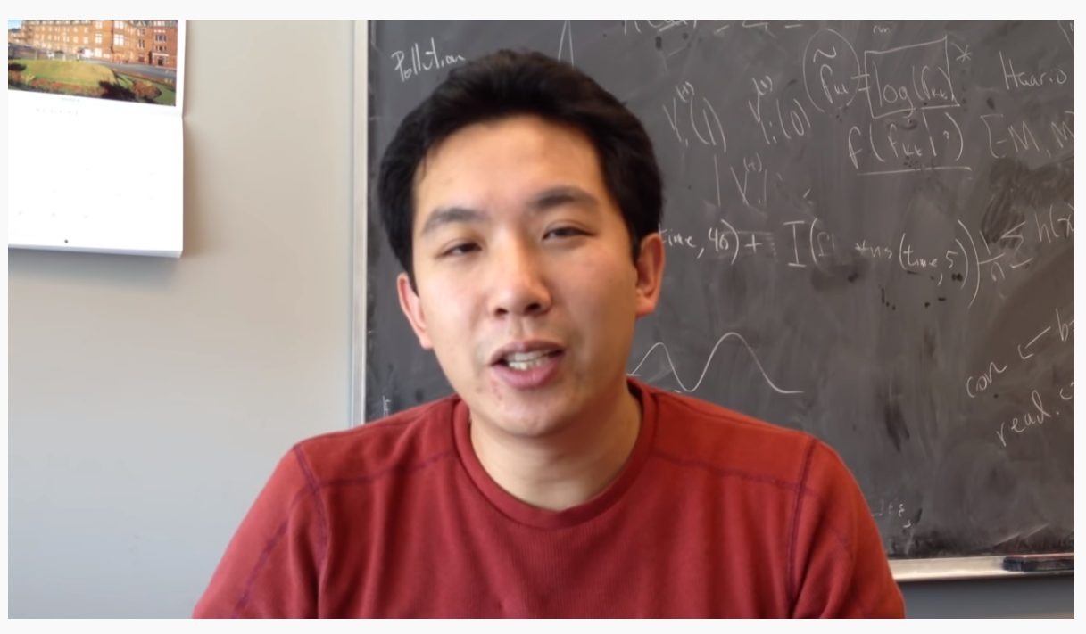
https://www.youtube.com/watch?v=ZXrHkIz-krE

Slide 24
References:
https://rmarkdown.rstudio.com/articles_intro.html
https://bookdown.org/yihui/rmarkdown/powerpoint-presentation.hthttps://rpubs.com/RatherBit/90926ml
https://r4ds.had.co.nz/

